Slide 1
Otis D. Wright, II, U.S. District Judge
Rozella A. Oliver, U.S. Magistrate Judge
Amanda M. Bettinelli, Assistant U.S. Attorney
Cathleen Cunningham, LMFT
Raul Ayala, Supervising Federal Public Defender
Kristie Rzonca, U.S. Probation Officer
Timothy J. Searight, Assistant U.S. Attorney
────────────
INTEGRATED CARE CONFERENCE
Hilton Universal City Hotel
October 24, 2018

Slide 2
MISSION STATEMENT
The mission of STAR is to increase community safety by providing a Court team approach that provides accountability, treatment, recovery services and other resources to individuals on community supervision to assist them in changing their behaviors so that they live sober, law-abiding and productive lives.

Slide 3
STAR HISTORY
Established in January 2010
─ Under the leadership of U.S. District Judge Otis D. Wright, II
Collaboration Between 4 Federal Court Agencies And Treatment Providers
U.S. District Court
U.S. Probation
U.S. Attorney’s Office
Federal Public Defender’s Office
MH/SA Treatment Provider
Post-conviction Program For Individuals On Federal Supervision
Created To Address Substance Abuse And High Recidivism Issues
─ Transitioned from traditional “re-entry” to “violator’s” court to increase participant pool
─ Integrates drug & alcohol and mental health treatment with criminal justice system case monitoring
Based on 10 Principles of National Association of Drug Court Professionals (“NADCP”)
THE STAR TEAM

Slide 4
STAR AT-A-GLANCE
Undergo Intensive Supervision
Submit to Random Drug Testing
Attend Other Treatment, as directed by Team
Participate in Drug Treatment
Participate in Mental Health Treatment, if needed
Attend Mandatory STAR Court Sessions
Attend 3 Self-Help Meetings Weekly
Demonstrate Productive Lifestyle – Work and/or School
─ Obtain a Sponsor/Work the Steps
Mandatory Goal Setting
Clearly Defined Benchmarks of Success
Alternative to Custody
Participant Check-In

Slide 5
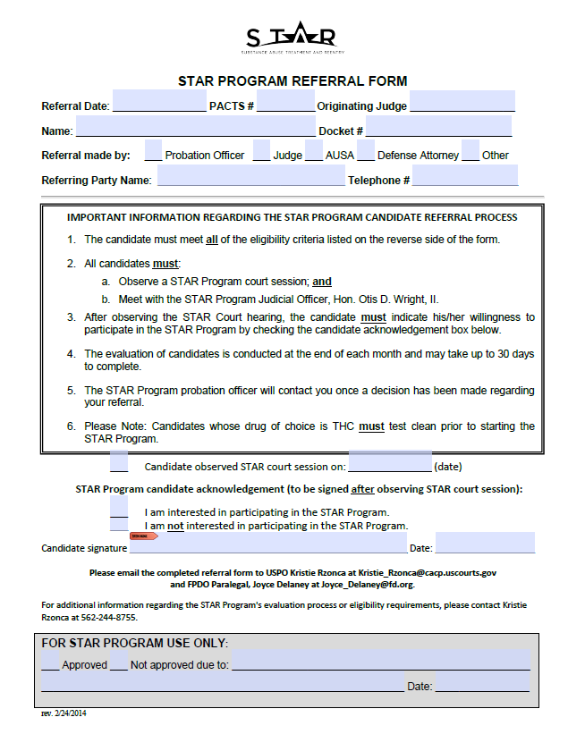
PARTICIPANT REFERRAL PROCESS
TRANSITION FROM RE-ENTRY TO “VIOLATOR’S” COURT
─ Demonstrated need for increased supervision accountability
─ Marked increase in participant pool
BEFORE ACCEPTANCE STAR APPLICANTS MUST:
Meet all eligibility requirements on STAR referral form
Observe 4 consecutive STAR court sessions
To demonstrate willingness and ability to comply with STAR rules
Meet 1:1 with STAR Judge
Have no pending federal court hearings
Must test clean (UA)
PRIMARY REFERRAL SOURCES
─ Judges
─ Probation Officers
─ Defense Attorneys

Slide 6
Evidence Based Risk Needs Assessment
PCRA: Post Conviction Risk Assessment Tool Used by USPOs to
Identify Dynamic & Criminogenic Risk Factors
COGNITIONS
SOCIAL NETWORKS
HISTORY OF VIOLENCE
EMPLOYMENT
SUBSTANCE ABUSE
EDUCATION

Slide 7
COMPARISON OF ADULT SUPERVISION SYSTEMS
COUNTY SYSTEM
No Custody Time
Example: Possession of Controlled Substance
STATE SYSTEM
PAROLE CASES PRISON SENTENCE/PAROLE
Supervision upon release
AB109 ─ 3 Strikes
Example: Controlled Substances for Sale
FEDERAL SYSTEM
PROBATION CASES/ NO CUSTODY TIME Supervised Release: Separate court order after serving prison sentence Must serve at least 85% of prison sentence Example: Trafficking in controlled substances for distribution
PROBATION CASES

Slide 8
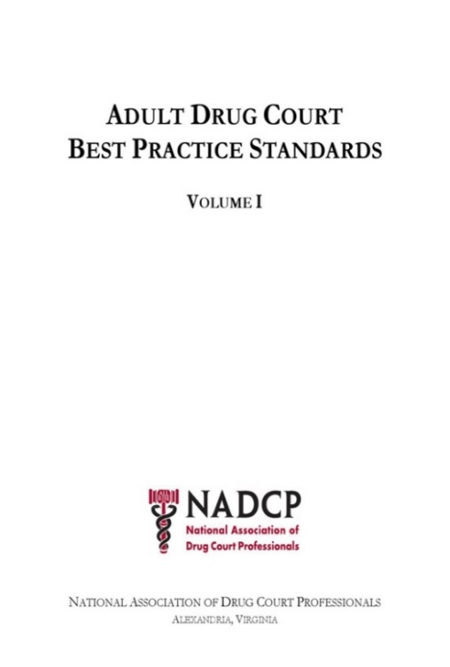
IMPLEMENTING EVIDENCE-BASED PRACTICES TEN KEY COMPONENTS OF DRUG COURTS
Justice and Treatment Integration
Non-adversarial Approach
Identification of Eligible Participants
(High Risk/High Needs)
Continuation of Treatment Services
Frequent and Random Drug Testing
Coordinated Strategy of Participant Compliance
Judicial Supervision/Interaction
Monitoring and Evaluation of Program Goals & Outcomes
Interdisciplinary Education
Develop & Foster Community Partnerships
www.AllRise.org

Slide 9
Key Service Components
Voluntary Participation
─ Participant can “opt out” of program
Identify High-Risk and High-Needs Individuals
─ Must have documented substance abuse history
─ Must have demonstrated need for increased accountability
Provide Comprehensive Substance Abuse and Mental Health Treatment
Utilize Collaborative Team Approach
Active Judicial Interaction and Intervention
Addition of Mag. Judge Oliver in LA to provide continuous judicial involvement
STAR Court Expansion to Eastern Division (Riverside) and Surrounding Area
Use of Graduated Sanctions & Incentives*
Participant provide feedback on program with “Participant Satisfaction Survey”

Slide 10
STAR UTILIZES GRADUATED SANCTIONS
RELAPSE
Reassessment of needs (RNR)
Increased Testing and/or Treatment
TECHNICAL VIOLATIONS
Judicial admonishment/intervention
Cognitive Model
Flash incarceration
ABSCONDING
STAR Status Conference Hearing
Treatment, if relapse related
NEW CRIMINAL VIOLATIONS
Flash incarceration
Program Termination
Participants can rejoin STAR after being terminated.

Slide 11
CLINICAL ASSESSMENTS
BASELINE/3 MONTHS/TERMINATION
ASI – Addiction Severity Index
PTSD Checklist – Civilian Version (PCL-C)
Becks Anxiety Scale
Becks Depression Scale
Hamilton Anxiety Assessment

Slide 12
STAR PARTICIPANT CHARACTERISTICS MENTAL HEALTH ISSUES
Significant & Undiagnosed MH Issues, including 1 or more of the following MH conditions:
Current Participant Population is
100% Co-Occurring

Slide 13
MENTAL HEALTH TREATMENT MODALITIES
TF-CBT
EMDR
Anger management
Solution Focused
Motivational Interviewing
Gestalt

Slide 14
INTEGRATED MENTAL HEALTH TREATMENT
Individual Psychotherapy
Mental Health Tx at the Courthouse
Crisis Intervention
On Call Counseling
5150
Case Management
Drug Detox
Residential
Housing Referrals
DMH Partnerships
SPA 4 Services
IOP Services
FSP Referrals

Slide 15
PARTICIPANT CHARACTERISTICS
GENERAL BACKGROUND INFO
LIMITED OR NO WORK EXPERIENCE
UNHEALTHY PEER ASSOCIATIONS
UNSUITABLE HOUSING OPTIONS
STRAINED FAMILY RELATIONSHIPS
DIFFICULTY IN PARENTAL ROLE
MOST HAVE 9th, 10th GRADE EDUCATION

Slide 16
STAR PARTICIPANT CHARACTERISTICS
CRMINAL HISTORY BACKGROUND
Most Present w/Significant Criminal History
─ Criminal History Categories IV, V and VIs
─ 87% w/Gang Ties/Affiliations
─ Average 10+ years in custody, not including juvenile convictions

Slide 17
UNDERLYING CRIMINAL CHARGES
Drug Offenses Highest % of Criminal Cases
N=23

Slide 18
STAR PARTICIPANT CHARACTERISTICS SUBSTANCE ABUSE HISTORY
Significant & Documented SA Hx
Most have no prior SA Tx
Prone to relapse
Primary DOCs: Meth, Cocaine, Heroin and Alcohol
In “Violation” Status w/the Court prior to Joining STAR
─ Average 3 or More Positive, Missed, Diluted UA Tests
MOST BEGIN DRUG USE PRIOR TO AGE 18

Slide 19
STAR INTERVENTIONS
STAR TREATMENT INTERVENTIONS
Individualized Treatment Plan
Substance Abuse Tx, as indicated
Residential, IOP, MAT, SA Group/Individual, Gender-based Tx
Therapist Added to Team
Psych Referrals for Medication Evaluation
STAR Check-Ins
Promotes Accountability
Immediate Judicial Interventions
‘Thinking it Through’ Modalities
Cognitive Behavioral Groups
Promote/Reward Pro-Social Behaviors
Attendance in weekly self-help meetings
Monthly Service Commitment at The Midnight Mission
Fish Bowl Draw
4 wks. compliance
Use of Collateral supports:
FPDO MSW interns
Develop Good Decision-Making Skills
Moral Recognation Therapy
1:1 Meetings w/Judge

Slide 20
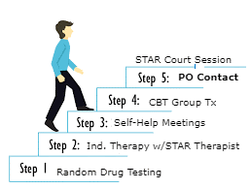
TYPICAL TREATMENT WEEK
Random Drug Testing
Individual Therapy w/ Team Therapist
Attend 3 Self-Help Meetings (NA, AA, Al-Anon)
Fellowship with NA Community
─ Work the Steps with a Sponsor
─ Read Big Book (donated to participants by STAR)
Attend Weekly CBT Group
Relapse Prevention Weekly
Attend STAR Court Session
Contact with Probation Officer

Slide 21
STAR BY THE NUMBERS
Total No. of Participants* | Total No. of Graduates* | Average No. of Participants | Average No. of Yearly Referrals
182 | 65 | 32 | 90
*total no. since January 2010

Slide 22
GRADUATION REQUIREMENTS
Participate in STAR for at Least 1 Year
Prepare & Present Relapse Prevention Plan
Clean and Sober 6 Months
90 Consecutive Days of Compliance
Maintain Stable Housing and Employment
Complete Participant Satisfaction Survey
Exit Interview with STAR Judges

Slide 23
LESSONS LEARNED
Individualized Treatment Plans
Meeting Participants Where They Are
Expansion of the Program to Eastern Div. (Riverside)
“Give Me 90 Days”
– Building Participant Trust in the Process
– Survey Participants for Feedback
It Should be Harder to Get Out, Than It is to Get In
– Allowing Participants to Rejoin After Termination
Clean Up, Where You’ve Messed Up – Restorative Justice Principles
– Monthly Service Project

Slide 24
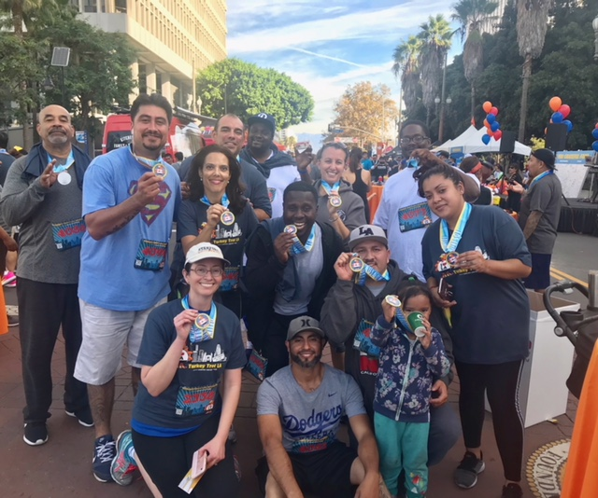
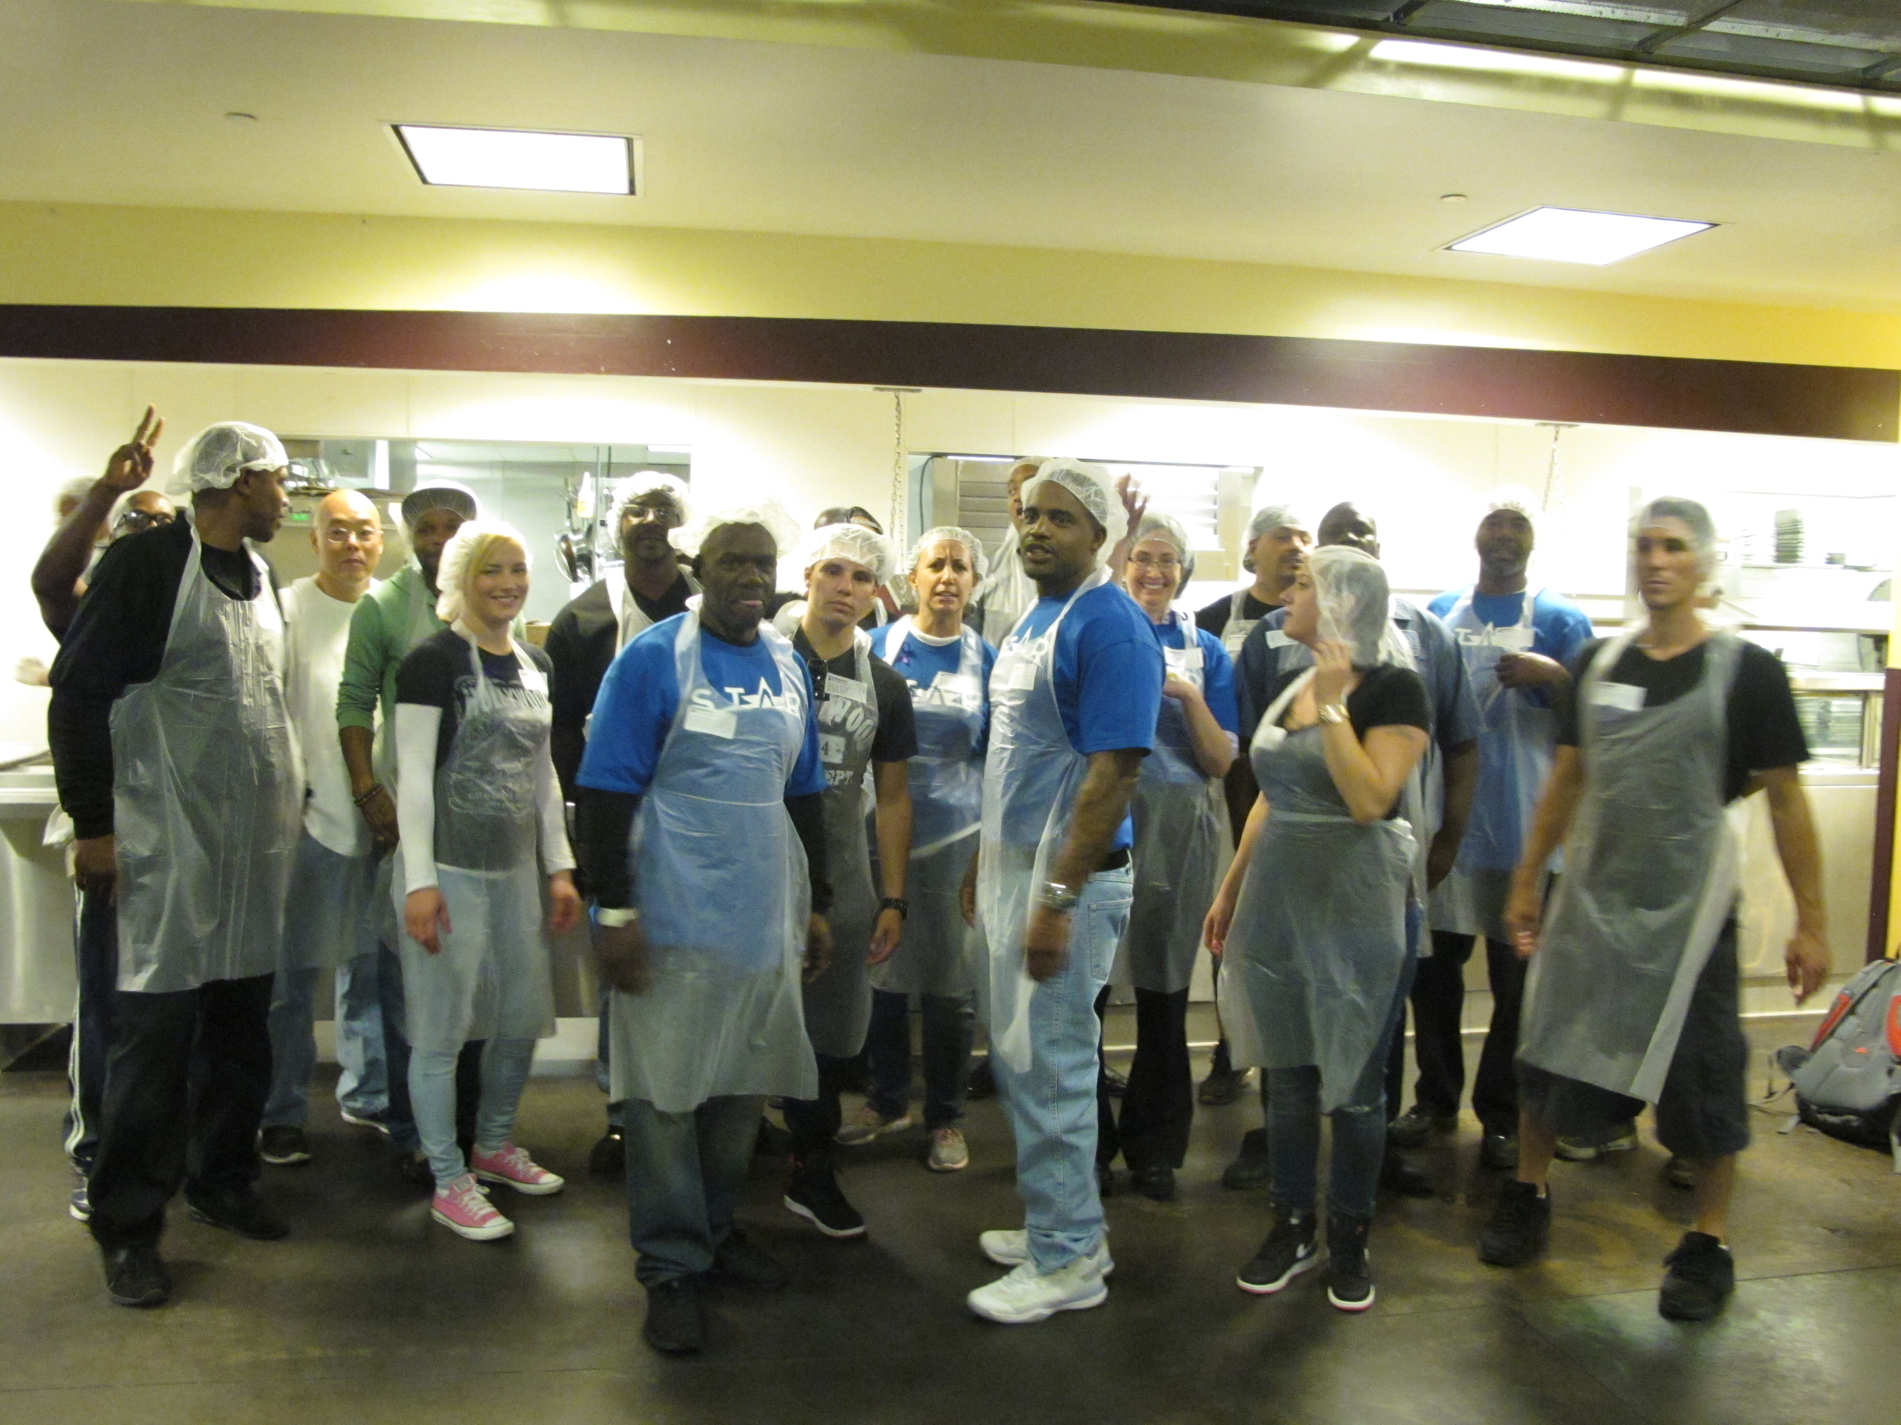
COMMUNITY PARTNERS
Emerging Leaders Academy
Goodwill Industries
Homeboy Industries/Homegirl Café
L.A. Kitchen
─ Culinary Arts Training Program
Los Angeles City Library
Narcotics/Alcoholics Anonymous
Project Fatherhood
The Midnight Mission
─ Monthly Lunch Service
─ Participate in Annual Turkey Trot
Turkey Trot, Thanksgiving Day, 2017
Lunch service at The Midnight Mission

Slide 25
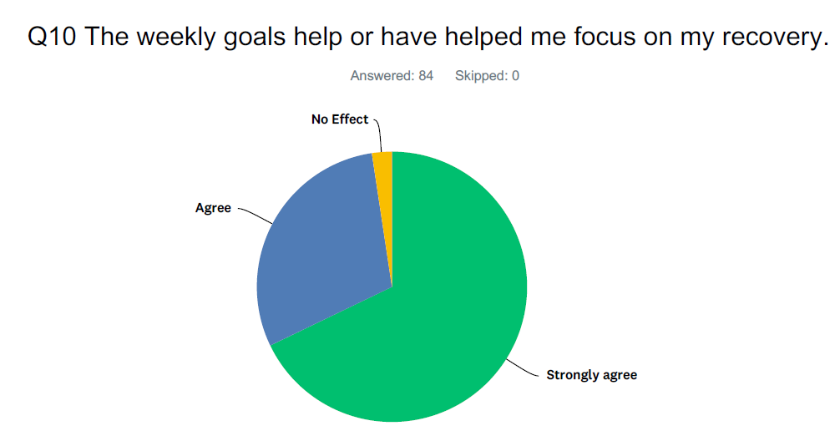
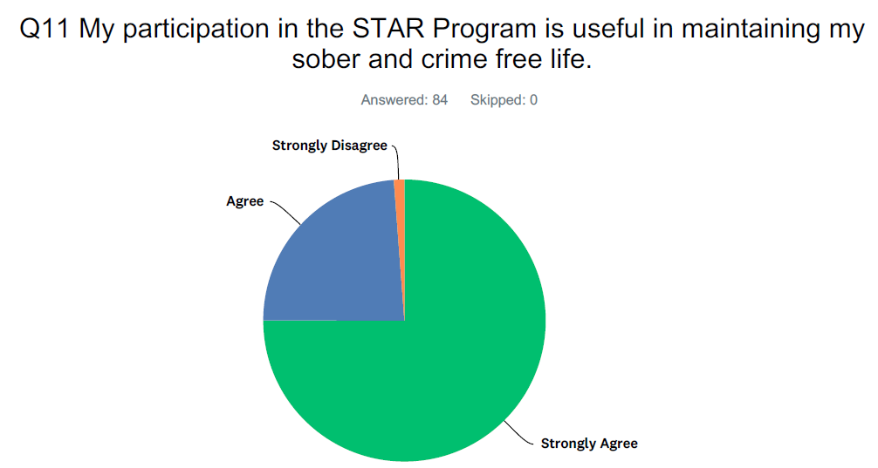
WHAT WE’VE LEARNED FROM OUR PARTICIPANTS
PARTICIPANT SATISFACTION SURVEY RESPONSES

Slide 26
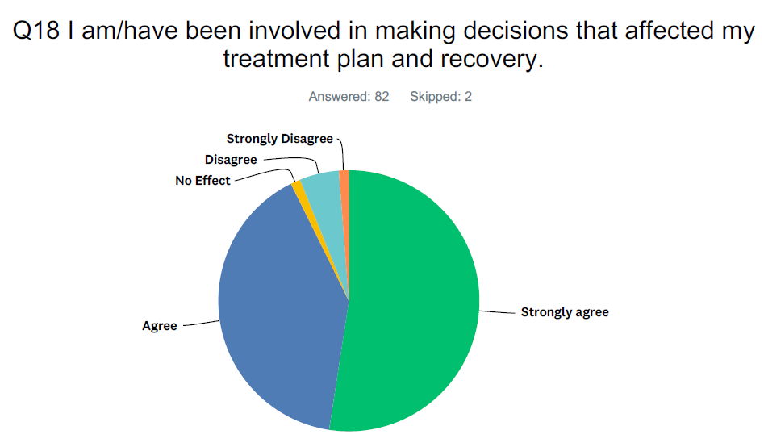
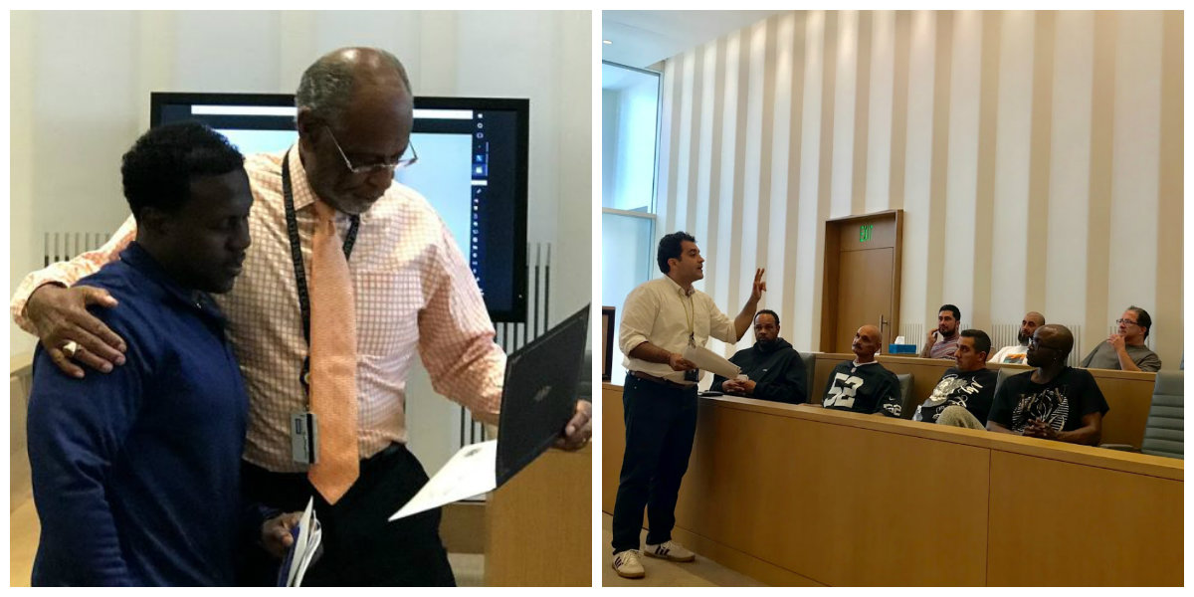
PARTICIPANT SURVEY RESPONSES

Slide 27
Q25 What aspect of the STAR program is/has been the most helpful to you in maintaining your sobriety and crime free lifestyle?
“STAR operates like family.”
“It was a chance to stay free.”
“I do not want to show up at the STAR and disappoint anyone and most of all embarrass myself. That's what is keeping me sober.”
“Almost going to prison losing every little thing I started.”
“Attending weekly meetings face-to-face.”
“Accountability/weekly check-ins.”
“It has maintained me. It helps to be surrounded with so much support.”
“The NA meetings and community service, as well as the support that is offered.”

Slide 29
THANK YOU!
For additional information about STAR, please contact one of the following team members:
Kristie Rzonca, United States Probation Office
Kristie_Rzonca@cacp.uscourts.gov
Raul Ayala, Collaborative Courts Supervising DFPD
Raul_Ayala@fd.org
Joyce Delaney, FPDO Paralegal
Joyce_Delaney@fd.org

